Slide 1

Parcel Delivery Trends: COVID-19 Impact Analysis
Exploring the seismic shifts in parcel delivery volumes and customer behavior during the COVID-19 pandemic
Data-driven insights into industry trends, customer segmentation, and future outlook
Presented by :-
Ashish Pandya
Dhruvil Patel
1

Slide 2
Executive Summary
COVID-19 Impact: Parcel volumes surged dramatically during 2020, driven by an e-commerce boom. Enterprise customers contributed the majority of the growth.
Customer Behavior: High Growth customers dominated, comprising 85.3% of the market, while new customers accounted for 1.9%. Declining customers represented 11.8%, highlighting retention challenges.
Volume Distribution: High Volume tiers dominated with 91.4% of total volume, showcasing significant reliance on large-scale customers.
Recommendations:
Focus on High Growth and new customers to sustain momentum.
Implement recovery strategies for declining and lost customers.
Optimize resources to prepare for future peak seasons.
2

Slide 3

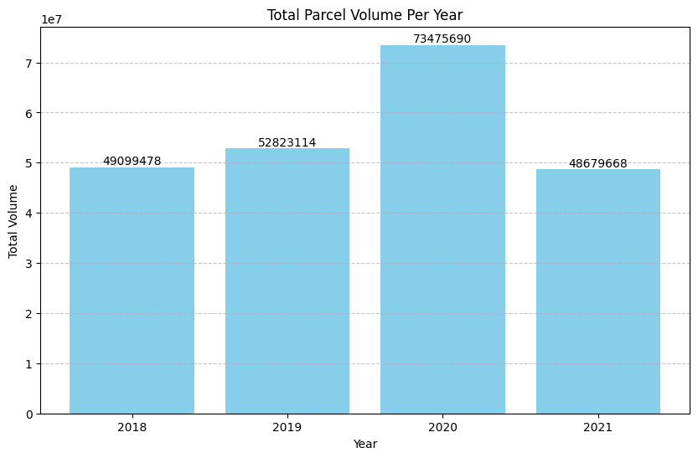
How did the COVID-19 pandemic impact ABC Company’s parcel business?
Significant growth in 2020
Peak parcel volume reached during pandemic year
E-commerce boom
Shift to online shopping drove volume increase
2021 decline
Volume decreased but remained above pre-2020 levels
3
Notes:
"COVID-driven e-commerce boosted 2020 volumes" This slide showcases the total parcel volume per year to highlight the growth in 2020, driven by the rise in e-commerce activity during the pandemic. The visual compares volumes from 2018 to 2021, with 2020 standing out significantly. Explain how lockdowns and changing consumer habits contributed to this increase. Emphasize the unprecedented growth rates during this period.
We Changed the graph representation from line to bar graph to understand the dataset.

Slide 4

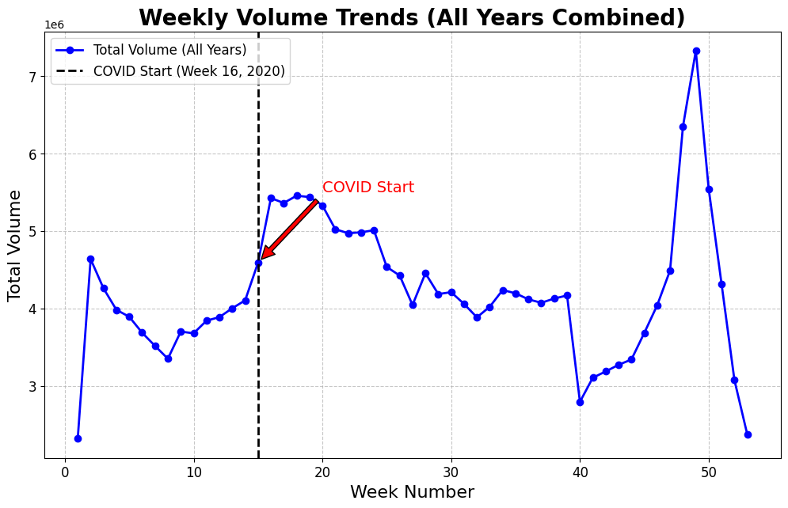
When were customer volumes first impacted by COVID-19?
1
Pre-pandemic trends
Consistent patterns from 2018 to early 2020
2
Pandemic Start
Marked by vertical dashed line at Week 16, 2020
3
Volume surge
Significant increase post-pandemic onset
4
2021 decline
Volume decreased but remained above pre-pandemic levels
4
Notes:
"Trends pre-pandemic, onset, and decline" This slide displays weekly parcel volume trends for multiple years to analyze patterns over time. Highlight the steady pre-COVID volumes, followed by a sharp increase during the pandemic. Explain key points like volume spikes during peak seasons (holidays) and consistent growth trends during 2020. Mention how 2021 began stabilizing post-COVID but retained higher levels than pre-COVID.
New changed:- Before I had graph which was showing the all-years volume data by week For example, it had 4 different lines before now I have combined everything in one graph.

Slide 5

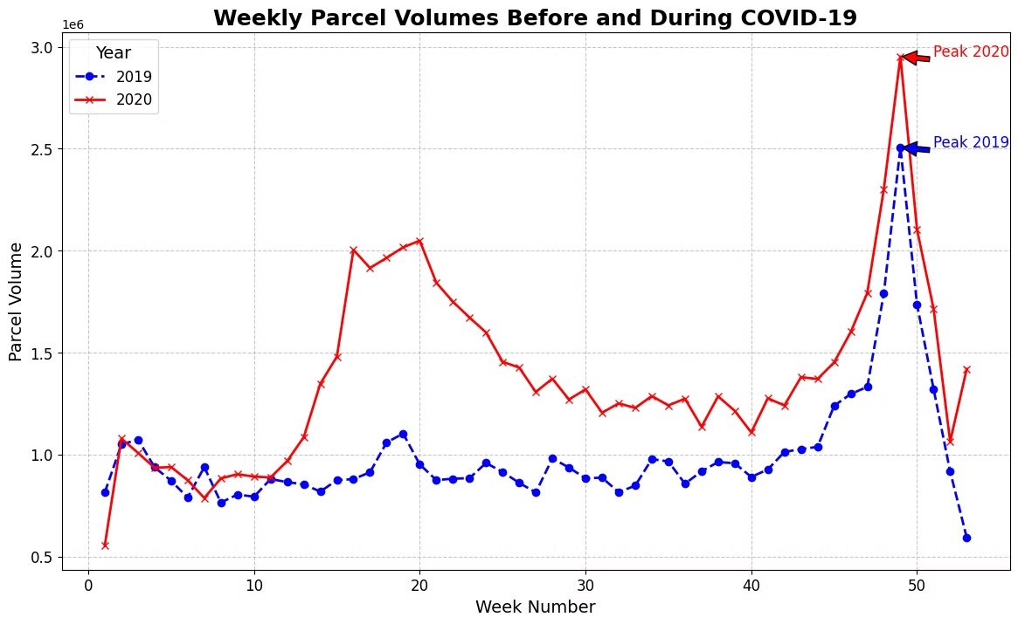




How did COVID-19 impact peak season in 2020?
2019 baseline
Typical seasonal patterns observed
2020 pandemic onset
Sharp increase around Week 16
Peak volume comparison
2020 peak significantly higher than 2019
Sustained growth
2020 volumes consistently above 2019 levels post-onset
5
Notes:
"2019 baseline vs 2020 peak volumes" This slide compares weekly parcel volumes between 2019 (pre-COVID) and 2020 (COVID-affected year). Discuss the sharp rise in volumes during Week 16 of 2020, coinciding with the onset of lockdowns and increased online shopping. Highlight how holiday seasons in 2020 surpassed 2019 significantly. Use this slide to showcase the pandemic's immediate impact.

Slide 6
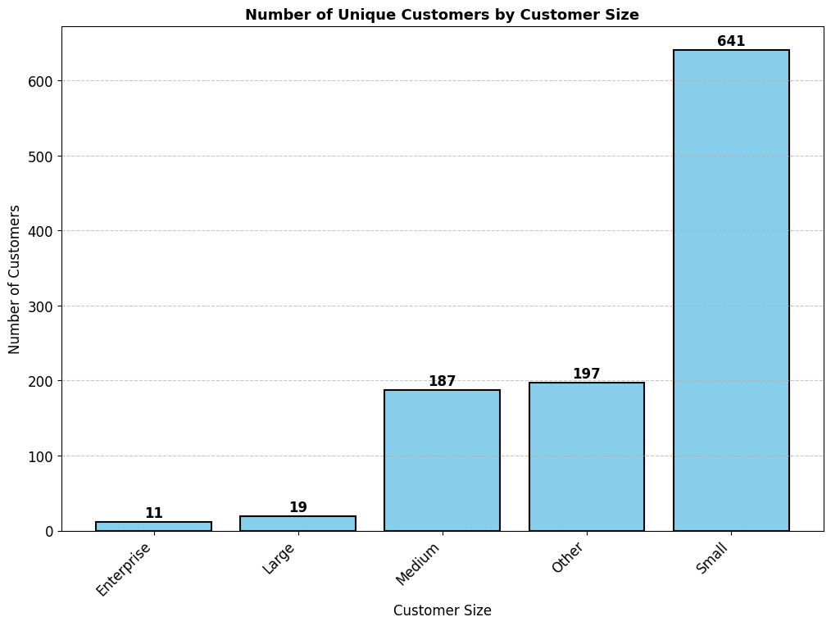
How has COVID affected companies
In the different customer groups ?
Enterprise
Large
Medium
11 Unique Count
19 Unique Count
187 Unique Count
Small
641 Unique Count
6
Notes:
Here We show the unique Customer that we found from different Customer Groups.

Slide 7
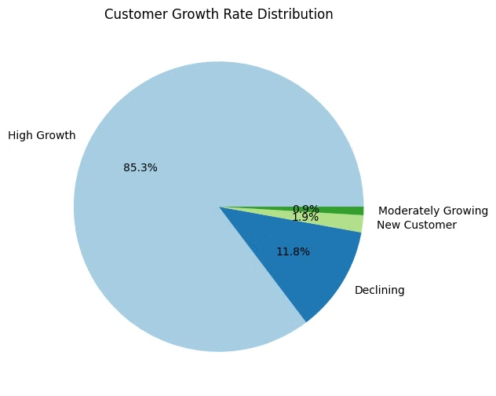
What percent of each customer group is growing, moderately growing, and declining during the COVID observation period?
85.3%
11.8%
High Growth
Declining
Majority of customer base
Significant portion facing challenges
1.9%
0.9%
New Customers
Moderately Growing
Small but crucial segment
Smallest segment of customer base
7
Notes:
"High growth drives post-pandemic recovery" This slide focuses on growth rate percentages for each customer group. Highlight that High Growth customers significantly contributed to the overall volume increase during the pandemic. Mention that Declining and Lost customers are present but form a smaller portion. Explain how this growth distribution reflects the resilience and adaptation of businesses during COVID.

Slide 8
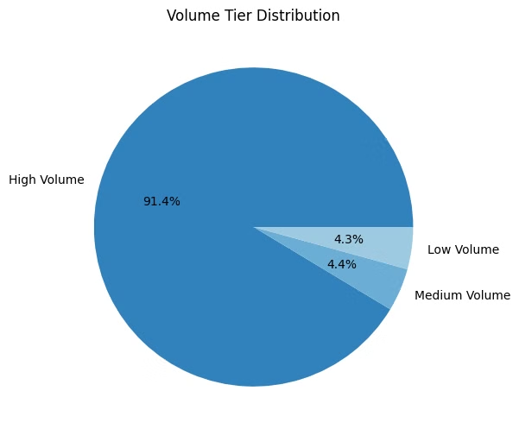
Volume Tier Distribution
1
High Volume
91.4% of total volume
Dominates the distribution
2
Medium Volume
4.4% of total volume
Significant but much smaller than High Volume
3
Low Volume
4.3% of total volume
Similar contribution to Medium Volume
8
Notes:
"91.4% of volume from high tier" This slide highlights the distribution of parcel volumes across tiers. Emphasize that over 91% of all parcel volumes during COVID came from the High Volume tier, reinforcing the dominance of top-tier customers. Conclude by stating that the High tier should remain a priority for business strategies.

Slide 9
Summary of COVID-19 Analysis
COVID's Impact:
Significant increase in parcel volumes during 2020 due to e-commerce growth.
Enterprise customers contributed the most to total volumes.
Customer Insights:
High Growth customers dominated, with new customers forming a notable portion.
Declining and lost customers present opportunities for recovery strategies.
Recommendations:
Focus on High Growth and new customers to sustain growth.
Implement retention strategies for declining/lost customers.
Prepare for peak seasons with resource optimization.
9

Slide 10
Thank you
10

